Slide 1
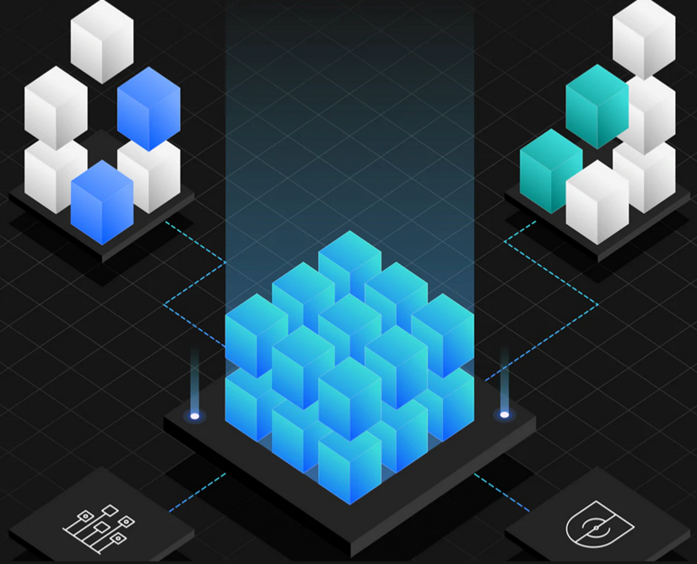
Optimize, modernize and cloud-enable your applications and operations — Liberty, IBM Cloud Transformation Advisor and Mono2Micro John Buckley, Product Manager john.buckley@ie.ibm.com Gary Juvinall Worldwide Sales Leader gjuvinall@us.ibm.com
Notes:
Purpose of this deck: The objective of this presentation is to prepare sellers to share the capabilities of IBM Cloud Transformation Advisor and Mono2Mico which are licensed with IBM WebSphere Hybrid Edition. These two tools can expedite the modernizing, cloud enabling, and migration of existing applications.
Contributors:
John Buckley, IBM Product Manager, john.buckley@ie.ibm.com
Cathy Daly, IBM Automation WW Technology Enablement, IBM Technology Sales, cdaly@us.ibm.com

Slide 2
Agenda
Why Modernize Recap
Modernization Accelerators Overview
IBM Cloud Transformation Advisor Fundamentals
WebSphere Migration Tools Fundamentals
IBM Mono2Micro Fundamentals
Seller Guidance (Typical Scenarios)
Opportunity Accelerators to Land and Expand
Resources and additional learning
Notes:
This is the agenda of the seller enablement material.

Slide 3
Minimize your Environmental impact by efficient use of compute resources and carbon-footprint to power them
Secure Digital Supply Chain and combat technical debt buildup by adopting modern software practices and standards
Facilitate Digital Transformation by aligning Application Delivery to Business imperatives
Align to your Business Goals
1
2
3
Digital Transformation
Sustainability
Security

Slide 4
Use WebSphere Hybrid Edition to optimize existing investments
Hybrid Multi-cloud IT
on any cloud platform
Address multiple motions with flexible license
1. Build New Cloud Native
2. Migrate (Lift and Shift)
3. Modernize and/or Migrate to Cloud
IBM Cloud
Google
3a. Modernize Runtime
Oracle
Azure
3b. Modernize Operations
3c. Modernize Architecture
AWS
Red Hat
… and IBM Infrastructure on-prem
4. Retain and Optimize on-prem
Rebalance your runtime deployments as needs shift using IBM’s flexible licensing
Notes:
WebSphere Hybrid Edition addresses each of these modernization motions. Whether modernizing and/or migrating to a hybrid multicloud, leveraging a public cloud (or clouds) of choice, as well as the ability to run in a client’s own datacenter on a private cloud or traditional architecture/infrastructure, with WebSphere Hybrid Edition clients have opportunity to select the right approach for an organizations needs. One size doesn’t need to fit all.
How do businesses do more with less? Businesses are seeking to simplify and right-size their environments and software investments by optimizing their applications and operations to increase efficiency. Business can unlock savings and add new value using container and cloud infrastructure and modernizing applications to take advantage of those platforms. By moving to a simplified container management and deployment model, businesses can cloud-enable their estate and use AI to help get there quicker. Cloud architected runtimes like Liberty also help to drives down infrastructure costs in conjunction with moving workload to a more efficient DataCenter and/or reducing server sprawl through a higher density of workload per server in containers, VMWare or on IBM infrastructure such as IBM Power or IBM Z Systems.
With flexible choices of where clients run their business logic, they can also better tackle compliance around Data Sovereignty.
Flexible licensing with WebSphere Hybrid Edition means businesses can run applications anywhere and at whatever stage in the modernization journey they are at, so modernization project doesn’t get held up in procurement discussions. Modernization will take time, ensure the client has the right partner for the journey!

Slide 5
Modernization Benefits
Runtime Modernization
Align Application Development to modern Java standards
Right-sized runtime
Reduced tech debt
Leverage new capabilities
Operational Modernization
Adopt on-demand compute and immutable infrastructure
Easier automation
Increased density
Architectural Modernization
Align Application Delivery to business change dynamics
Increased Agility
Rapid Innovation
Notes:
TBD - JOHN REWORK

Slide 6
Addressing Technical Debt From Vicious Cycle to Virtuous Cycle
Difficulty to upgrade middleware
Methods & Processes lack efficiencies
Difficulty to enhance apps
Apps atrophying
Weak Security Posture
2. Adopt Independent Immutable Deployments
3. Adopt Automation for DevOps
Vicious Cycle
1. Adopt modern lightweight runtime for app
4. Balance paying down debt and new function in each Dev cycle
(or next piece of app - strangler pattern)

Slide 7
Modernizing your Runtime to Liberty removes technical debt!
- Supports Java EE, Jakarta EE, MicroProfile, great for monoliths, macroservices and microservices
Improve Sustainability and Lower infrastructure costs
Just enough runtime
80% disk and 56% memory saving
Lower operating cost
4x increased density over Tomcat & Spring Boot
Improve Security and Lower Administrative costs
Continuous delivery
Zero-effort security fixing & zero technical debt
100% v2v & fixpack migration saving
Zero migration
Increases Developer and Digital Productivity
Kubernetes Optimized
Self-tuned optimal perf, production-ready, kube-native
Developer Optimized
Container & VM experience for rapid dev-test-debug
Notes:
ibm.biz/6ReasonsWhyLiberty
The slide shows the top six reasons why Liberty is a great choice for modern cloud-native applications, including modernizing existing enterprise workloads. The slides that follow go into more details on each, but they generally equate to three top-line messages:
Liberty is extremely efficient versus competitors and can save client’s money purely in execution and license costs.
Liberty is the only runtime in the world with zero migration and continuous delivery, which makes it ideal for modern DevOps delivery practices.
Liberty is designed to work seamlessly in Containers, Kubernetes, and OpenShift Container Platform (OCP) environments, simplifying development and abstracting or completely removing much of the operational pain, such as tuning.
The chart and highlights on the left are from a Forrester Total Economic Impact (TEI study: ibm.biz/WSHE-TEI). Forrester interviewed clients who had adopted Liberty to understand the benefits. Based on their analysis, they found that modernizing to Liberty can achieved an ROI of 195%, with average payback happing in 8 months.

Slide 8
Modernization Accelerators Overview

Slide 9
The Modernization Journey - Recap
Modernize Runtime
Modernize Operations
Modernize Architecture
Transformation Advisor
Transformation Advisor
Mono2Micro
Server / VM
Server / VM
Container
Set of Containers
Monolith
Monolith
Monolith
Microservices
Traditional
Runtime (WebSphere, other J2EE)
Cloud-Native
Runtime (Liberty)
Cloud-Native
Runtime (Liberty)
Cloud-Native
Runtime (Liberty)
Traditional Operations
DevOps for Containerized Applications
Traditional Infrastructure
Kubernetes (e.g. Red Hat OpenShift)
Notes:
The starting point for modernization is often a Monolithic Application running of VMs on traditional infrastructure in the DataCenter with a traditional runtime such as WebSphere ND or other J2EE application server. Deployment of applications is typically done in a change window, often involving manual steps.
<Click>
Because Liberty supports deploying both in VMs and in Kubernetes very well, this allows operations teams to replace Traditional WebSphere with a cloud-native runtime on their existing infrastructure with familiar operations practices as an initial modernization step. Transformation Advisor provides expert assistance for any required code changes to cloud enable applications and start benefitting from Cost Savings and Technical Debt Reduction. For enterprises that do not yet have a Container Platform (private Cloud) strategy, Runtime Modernization to Liberty in VMs facilitated by Transformation Advisor is an excellent first step.
<Click>
Operational modernization involves moving from traditional VMs to a more automated and agile DevOps SDLC using containers and Kubernetes.
<Click> Transformation Advisor provides DevOps starters to accelerate automation of application deployment in containers helping bridge any skills gap.
<Click>
This is the ideal basis to do further architectural modernization for those applications that would benefit from microservices based approaches. IBM Mono2Micro provides AI to help decompose large monolithic applications, recommending how to partition and generating code to help with microservice interactions.
Additionally, Cloud Transformation Advisor can help modernize applications that depend on any traditional J2EE Application Servers such as IBM® WebSphere®, Red Hat® JBoss, Oracle WebLogic, Apache Tomcat (as well as IBM Integration Bus).
The Tools facilitate an incremental approach to modernization that minimizes risk and delivers value at each step. Along with flexible licensing in WebSphere Hybrid Edition, enterprises can confidently modernize without fear of vendor lock-in knowing they are invested in standards, open source and backed by best-in-class IBM support.

Slide 10


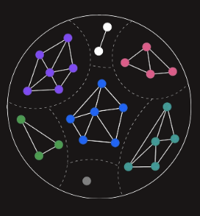
Traditional WebSphere and Liberty Modernization Tool Suite
Operational Modernization
Architectural Modernization
Runtime Modernization
WebSphere Application Migration Toolkit
IBM Cloud Transformation Advisor
IBM Mono2Micro
Command line and IDE-based tool for version-to-version migration, Liberty modernization and Cloud deployment scenarios and providing automated code migration via OpenRewrite recipes
On-premises workload analysis for runtime and operational modernization, including application modernization complexity, development cost estimates and migration artifacts for individual applications and ND clusters
AI-drive method to refactor a monolithic application into microservices quickly and in a less disruptive way, regardless of skill level or technical knowledge
http://ibm.biz/wamtdownloads
http://ibm.biz/cloudta
http://ibm.biz/mono2micro

Slide 11


App Modernization Tools accelerate the planning, sizing and execution of the modernization journey
Advise
Move
Operational Modernization
Cost/complexity of cloud-enabling the application
Interdependencies with other apps and services
Generates migration artifacts to assist with build, deploy, operation in Cloud
Based on cloud native best practices
Runtime Modernization
Transformation Advisor
WebSphere Application Migration Toolkit
Architectural Modernization
How an application can be:
Decomposed along responsibility boundaries and/or
Refactored into a set of microservices
Generates code enabling communication between Liberty microservices
IBM Mono2Micro
Notes:
Alex
Transitions between solution architect, developer – how the tools fit
In the Planning phase, the tools give advice and recommendations. In the Move phase, the tools help with re-constructing the application in the new landing zone. The two tools that assist with the planning and moving are IBM Cloud Transformation Advisor and IBM Mono2Micro..
For advice on modernizing operations and runtimes, IBM Cloud Transformation Advisor helps understand the cost and complexity of cloud-enabling the application and interdependencies with other applications and services. When the applications landing zone is determined, IBM Cloud Transformation Advisor helps move the application by providing migration artifacts which help build, deploy and operate applications in Cloud using cloud native best practices.
For advice on modernizing the application architecture, IBM Mono2Micro provides recommendations how an application can be decomposed along responsibility, often organizational, boundaries and/or refactored into a set of microservices. Once the new architecture is determined, IBM Mono2Micro helps adapt the application by generating code for enabling necessary communication between Liberty microservices.
Note: There is no dependency to do between the 2 tools to do an assessment. Assessments can be done in parallel. However, the remediation to move to containers should be completed first before attempting to partition the application

Slide 12
Evolution of WebSphere to Liberty on Hybrid Cloud
a. Modernize Runtime
b. Modernize Operations
c. Modernize Architecture
WebSphere ND
Traditional J2EE Application Server with added Management & Orchestration functions
WebSphere Application Server: Base runtime providing Java SE and EE capability
WebSphere Liberty: Lightweight runtime for modern Java workloads and providing compatibility with WebSphere
Open Liberty: Fully open-source Java runtime ideal for cloud-native workload following latest Java standards
Hybrid Cloud: Take advantage of orchestration capabilities in your cloud of choice
WebSphere Application Server Base
Runtime Evolution
WebSphere Liberty
WebSphere Application Server ND
Open Liberty
Java 5,6,7
Java 11,17,…
Management & Orchestration
Heritage APIs
Java 8 EE7
J2EE/Jakarta EE 8, 9, 10, …
ILMT License Tracking
EE6 (Full Profile)
EE6 (Web Profile)
Microprofile
Container License Tracking
Hybrid Cloud

Slide 13
Runtime Migration options and Tooling Evolution
a. Modernize Runtime
b. Modernize Operations
c. Modernize Architecture
Transformation Advisor provides three runtime options for VMs or containers based on analysis from WebSphere Binary Scanner
WebSphere Liberty: Modernize to Liberty while keeping many traditional WebSphere capabilities. Best Modernization option for modernizing WebSphere workload.
Open Liberty: Modernize to the open-source Liberty. Excellent option for Java applications (using EE7 and above) running on open-source runtimes that are looking for improved Sustainability profile.
WebSphere Base In Containers: Valid option for certain application when operational modernization initiatives don’t yet have support from Application owners or Third-Party vendors
WebSphere Application Migration Toolkit (Source Scanner Eclipse Plugin) is now deprecated in favour of OpenRewrite Recipes
WebSphere Application Server Base
WebSphere Liberty
WebSphere Application Server ND
Open Liberty
Java 11,17,…
Management & Orchestration
Java 5,6,7
Heritage APIs
Java 8 EE7
J2EE/Jakarta EE 8, 9, 10, …
ILMT License Tracking
EE6 (Full Profile)
EE6 (Web Profile)
Microprofile
Container License Tracking
OpenRewrite Recipes
WebSphere Source Scanner
WebSphere Binary Scanner
Migration Tool Evolution
Jakarta 9 Java 17

Slide 14
IBM Cloud
Transformation Advisor Fundamentals

Slide 15

IBM Cloud Transformation Advisor
Operational Modernization
Java Enterprise Edition applications servers
WebLogic Server V6.x+
IBM WebSphere® Application Server V6.1, or later
Red Hat™ JBoss v4.x+
Apache Tomcat V6.0 (and later)
Java applications directly
Messaging
IBM Integration Bus Version 10.0
IBM App Connect Enterprise Version 11.0
IBM Cloud Transformation Advisor
On-premises workload analysis for runtime and cloud modernization, including application modernization complexity, development cost estimates and migration artifacts
Notes:
To validate the most current platforms supported check this web page on IBM Documentation: https://www.ibm.com/docs/en/cta?topic=about-transformation-advisor

Slide 16
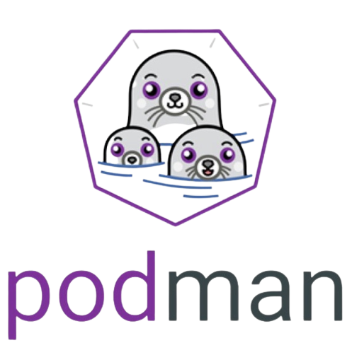

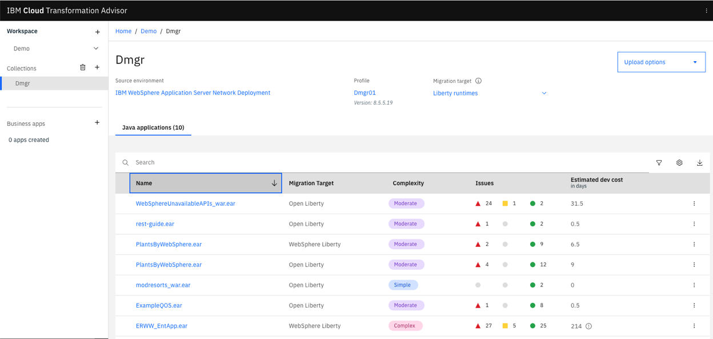
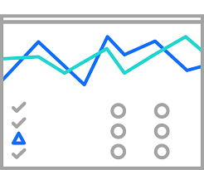



How IBM Cloud Transformation Advisor works
RHOCP or Desktop
Install Transformation Advisor from the IBM Catalogue on RHOCP, or use TA Local on your desktop and access the UI from your browser.
Download and run the Data Collector (or the latest Binary Scanner) on your on-premise servers, where your applications are already deployed.
Data Collector sends results back to TA or are uploaded through the browser.
Transformation Advisor’s analysis provides app-specific insights, guidance and developer effort sizings based on practitioners’ experience to move your application to the cloud.
Use the customized migration artifacts created by TA allow you to easily configure the runtime, containerize and deploy the application.
Transformation Advisor
Migration Artifacts
Liberty Container
On-premise
wsadmin or Binary Scanner
TA Data Collector
Notes:
This slide describes how clients can use IBM Cloud Transformation Advisor (TA).
First clients can install TA from the IBM Catalog on the OpenShift cluster or use TA Local on the desktop and access the User Interface from the browser.
Next, download and run the TA Data Collector on the on-premises servers where applications are running.
Once the application data is collected, the Data Collector will send the data back to TA.
Clients can now review the the analysis reports from TA which provides app-specific insights, guidance and developer effort to move client’s application to the cloud.
Based on the TA recommendations, clients can use the customized migration artifacts created by TA to create their application migration bundles which can be deployed to the cloud.

Slide 17
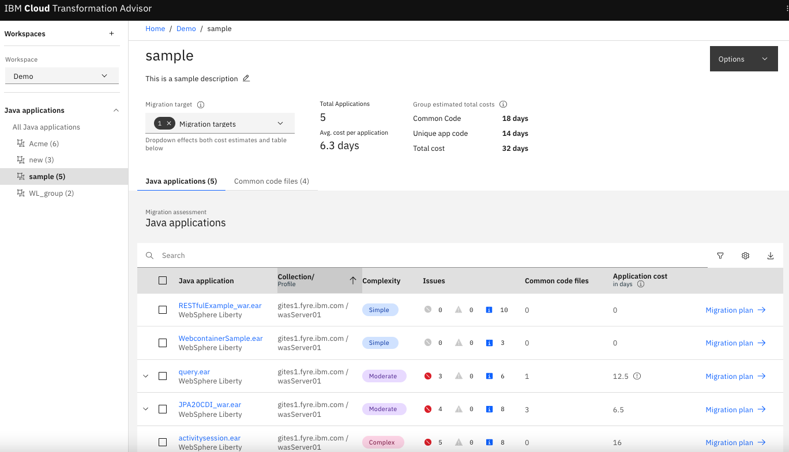
Application Complexity Assessment
a. Modernize Runtime
b. Modernize Operations
c. Modernize Architecture
Simple:
No code changes required
Moderate:
Some well-understood remediation needed
Complex:
May need to rearchitect or continue as-is

Slide 18
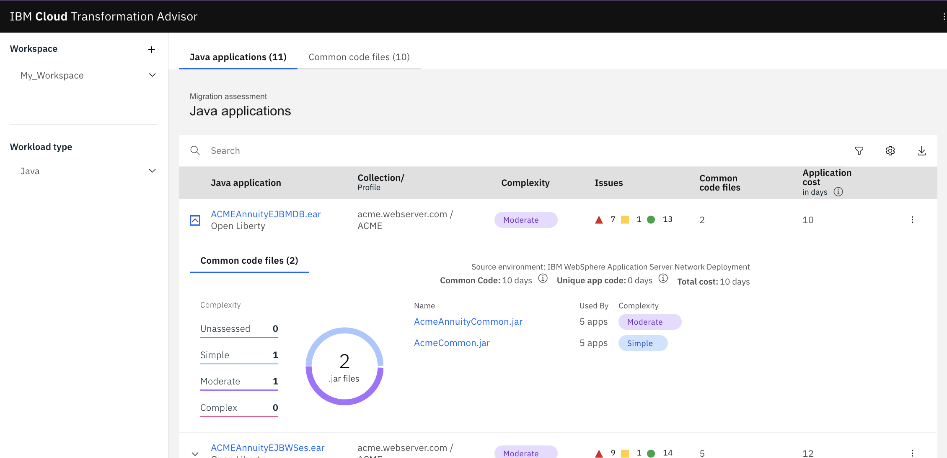
Development Cost - Individual Application
a. Modernize Runtime
b. Modernize Operations
c. Modernize Architecture
Application Development cost:
Including costs for shared library code

Slide 19
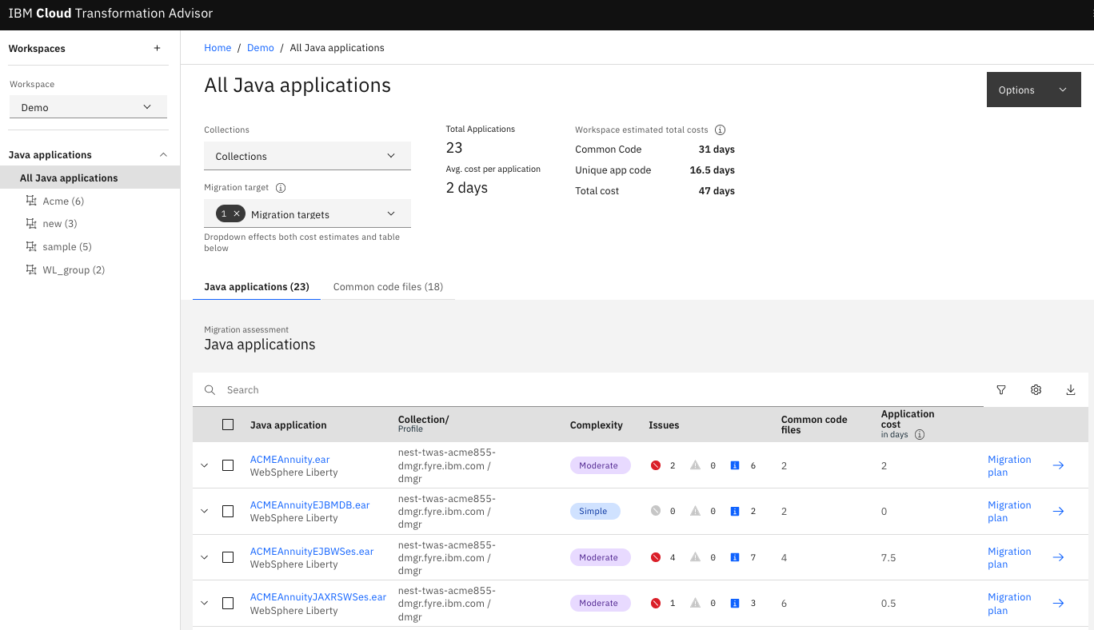
Development Cost – Enterprise wide
a. Modernize Runtime
b. Modernize Operations
c. Modernize Architecture
Enterprise-wide Development cost:
Common code is identified for enterprise-wide planning

Slide 20
How Enterprise-wide development cost accounts for shared code
a. Modernize Runtime
b. Modernize Operations
c. Modernize Architecture
Customer-configured common code: JAR files from shared libraries
TA also dynamically discovers common code: JAR files included in multiple applications (identified by a combination of name and checksum)
➤ Remediating common code in a JAR one time speeds modernization of all applications that depend on it
➤. Developer effort to remediate common issues will be significantly less than it might appear when looking at apps one-by-one
App3
App4
App 5
App2
App6
App1
Jar2
Jar3
Jar4
Jar1
Issue1
Issue2
Issue3
Issue4

Slide 21
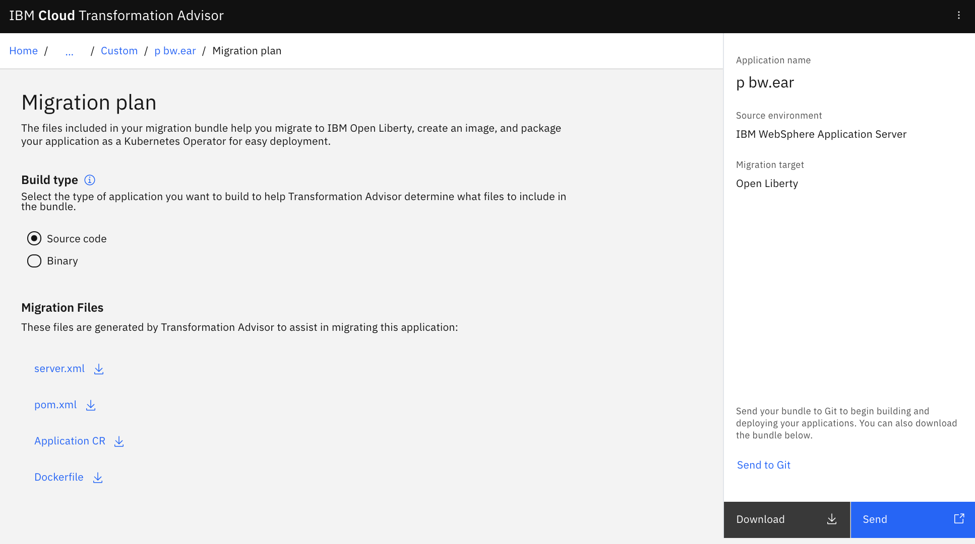
Migration Artifacts for Individual Application
a. Modernize Runtime
b. Modernize Operations
c. Modernize Architecture
Step 1:
IBM Cloud Transformation Advisor automatically generates artifacts for existing application.
Step 2:
User will then containerize application running on liberty and deploy to OpenShift.
Step 3:
IBM Cloud Transformation Advisor can help push migration bundle to desired GitHub repository.
Notes:
IBM Cloud Transformation Advisor produces migration artifacts for existing applications that can be migrated to Liberty on Red Hat OpenShift without any code change. The migration artifacts kickstart the migration of client’s application. IBM Cloud Transformation Advisor generates a project for the application plus the resources need to build the application into an image which then can be deployed to an OpenShift cluster.
server.xml is generated to encapsulate the configuration of the application, incorporating only the needed APIs. pom.xml is generated to help build the application using Maven.
Dockerfile is provided as a container definition incorporating the application jars (built from Maven), third party jars (retrieved by Maven) plus the server.xml.
Application CR is an example of the yaml file that can be used to deploy Liberty operator (as a Kubernetes Custom Resource) using the container image.

Slide 22
Migration Artifacts for whole ND clusters
a. Modernize Runtime
b. Modernize Operations
Low-cost, low risk first step to operational and runtime modernization
Familiar topology, modern runtime, modern platform
Accelerates cloud-native adoption, reduces skills gap
c. Modernize Architecture
Kubernetes Cluster
Kubernetes Cluster
dmgr
IBM HTTP Server
Route / Ingress
WebSphere plugin
Operator
manages
Transformation Advisor
Service
load-balances
load-balances
manages
Cluster
tWAS Cluster
Pod
tWAS cluster member
tWAS cluster member
Pod
Pod
Container
Pod
Container
Container
App A
App B
App A
App B
Generated artefacts:
Co-location aware Dockerfile & server.xml
Replica aware Custom Resource
Liberty
Container
Liberty
Liberty
App A
Liberty
tWAS cluster member
tWAS cluster member
App B
App A
App B
App A
App B
Futures: customizable Custom Resource, secrets migration
Notes:
22
Sometimes you may need to modernize a cluster of applications rather than take an application-centric approach:
Applications need to be deployed to the same JVM to function
For example: local EJB calls
Applications need to scale together
Easier for the business to keep cluster of applications together

Slide 23
IBM Cloud Transformation Advisor License and Entitlement
Licensing FAQ in Seismic →
Product name & version | License ID | Link to License
IBM WebSphere Hybrid Edition 5.1 | L-AMIK-C92MN6 | → Review License
IBM Cloud Transformation Advisor 3.6.0 (Evaluation) | L-YZFX-YGXNEL | → Review License
IBM Cloud Pak for Integration 2023.2.1 | L-YBXJ-ADJNSM | → Review License
IBM Cloud Pak for Integration Limited Edition 2023.2.1 | L-PYRA-849GYQ | → Review License
IBM Cloud Pak for Applications 5.1 | L-AMIK-BYM26G | → Review License
IBM Cloud Pak for Applications Limited Edition 5.1 | L-AMIK-BYM2RQ | → Review License
IBM WebSphere Application Server for z/OS 8.5.5 | L-CTUR-C7K3YZ | → Review License
IBM WebSphere Application Server for z/OS 9.0.5 | L-CTUR-CBPUER | → Review License
Notes:
IBM Cloud Transformation Advisor is available at no cost for 90 days with the Evaluation license. Continued use of IBM Cloud Transformation Advisor beyond the 90-day evaluation period on certain platforms is available if the client has entitlement to any of the IBM products listed here: https://www.ibm.com/docs/en/cta?topic=started-license-information WebSphere Hybrid Edition includes IBM Cloud Transformation Advisor as part of its bill of materials.
Additional Licensing FAQ https://ibm.box.com/v/TALicensingFAQ

Slide 24
IBM Cloud Transformation Advisor system requirements
IBM Cloud Transformation Advisor can be deployed on these platforms:
Platform/OS | Support | IBM Cloud Transformation Advisor 90-Day Free Evaluation | Productive Use | Installation | Hardware
OCP 4.10, 4.12 | Full | Yes | Yes, apply key | install via Operator | x86_64/Power/IBM Z
RHEL 7.9+ | Full | Yes | Yes, apply key | installation guide | amd64
Windows v10, v11 | Limited | Yes | No | installation guide | Desktop/Laptop
For latest, see documentation →
Notes:
IBM Cloud Transformation Advisor does not support installing on IBM Cloud® Kubernetes Service. The only Kubernetes platform that Transformation Advisor supports installing on is Red Hat OpenShift Container Platform - which may be deployed privately or on a public cloud.
To validate the most current platforms supported check this web page on IBM Documentation https://www.ibm.com/docs/en/cta?topic=getting-started
Note. The platforms that IBM Cloud Transformation Advisor can analyze and assess are different. The data collector can run on Linux: AIX, Solaris, z/OS and Windows. See https://www.ibm.com/docs/en/cta?topic=started-using-data-collector.

Slide 25
a. Modernize Runtime
b. Modernize Operations
c. Modernize Architecture
WebSphere Migration Tools Fundamentals

Slide 26



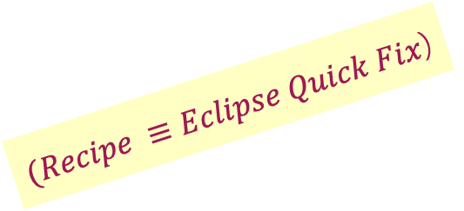
New: Automated Fixes on the Command Line via Recipes
One app or an entire estate?
v
1..N?
Refactor?
IBM Mono2Micro
One app
Yes
Monolithic
legacy application(s)
No
Binary or Source?
Eclipseor CLI?
*Rules
Source Scanner
Source
Eclipse
Some
*Quick Fixes
N Apps
Maven and Gradle
Binary
*Rules
Binary Scanner
*Recipes
$(Recipe ≡Eclipse Quick Fix$)
Data Collection
Some
User-Defined
Rules
User-Defined
Recipes
✅
IBM Cloud Transformation Advisor
v
Other IDEs
User-Defined Rules

Slide 27
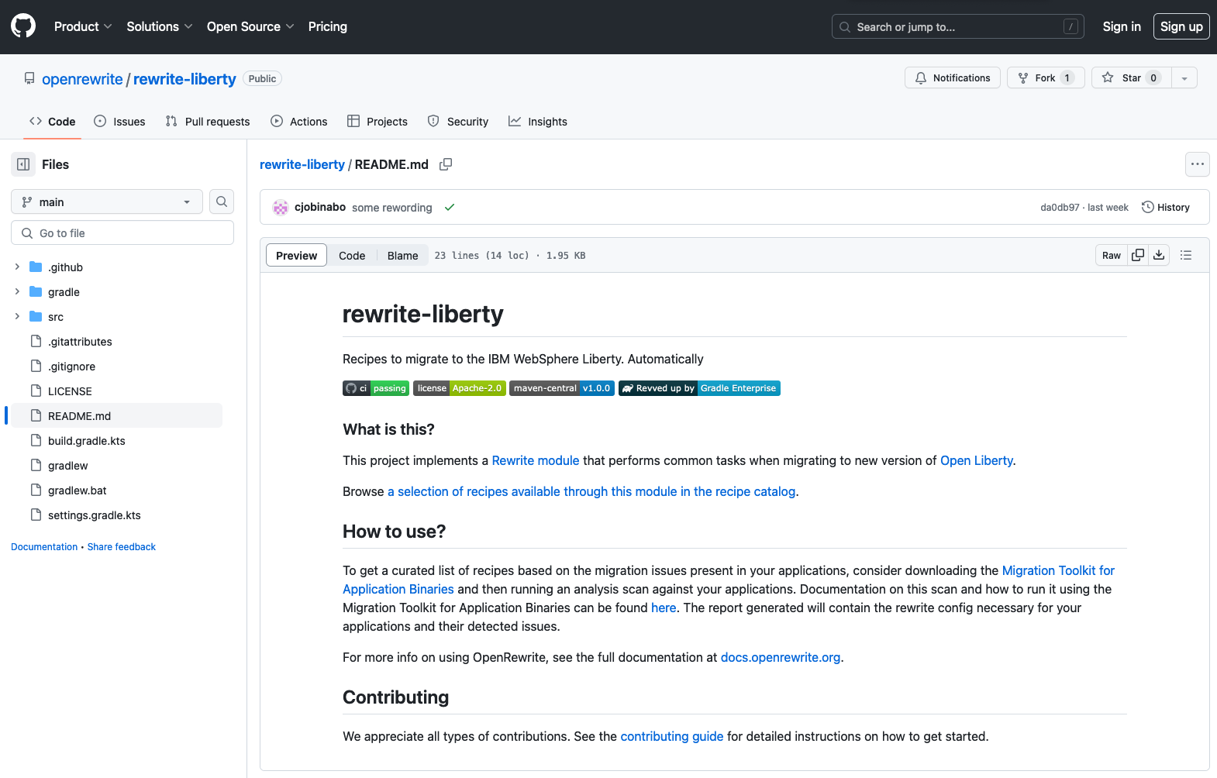
New: Automation Recipes with Liberty
Open Source project Rewrite modules to be executed through Maven and Gradle build invocation
https://github.com/openrewrite/rewrite-liberty
Notes:
https://github.com/openrewrite/rewrite-liberty

Slide 28
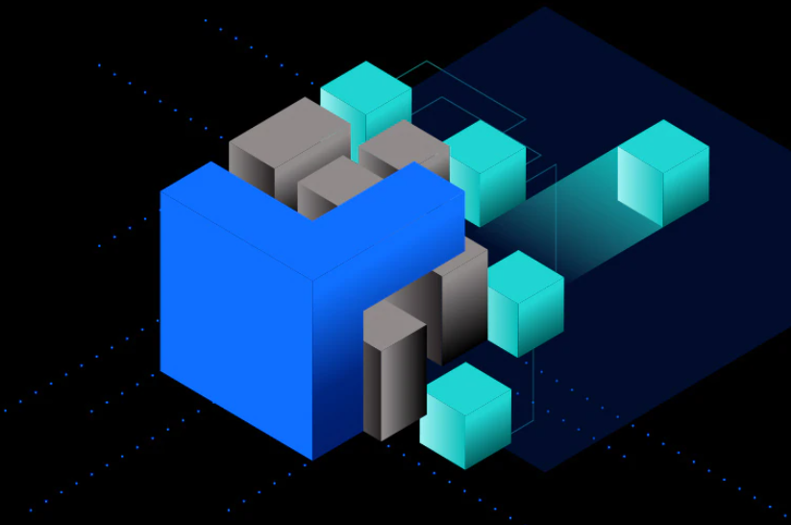
a. Modernize Runtime
b. Modernize Operations
c. Modernize Architecture
IBM Mono2Micro Fundamentals

Slide 29
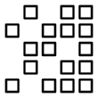


IBM Mono2Micro
AI based automatic transformation of monoliths into microservices
Monolith
Microservices
Microservice Generation Engine
AI identifies high cohesive, low coupling components
Generated Microservices ready to be deployed
User can interactively refine recommended Microservices
Generates starter code for communication between microservices
IBM Mono2Micro’s AI capabilities generate recommendations, semantic analysis, and significant portion of code needed for refactoring
Notes:
Using machine learning and deep learning, the semi-automated revolutionary IBM Mono2Micro utility provides deep semantic analysis of an application’s microservices along with the Representational State Transfer (REST) APIs for their invocations. IBM Mono2Micro lets clients transform their monolith applications into microservices without rewriting them. Mono2Micro’s AI capabilities generate recommendations, semantic analysis, and a significant portion of the code needed for refactoring. IBM Mono2Micro, available exclusively in WebSphere Hybrid Edition, is an automated AI driven utility for fully understanding the complexities of an organization’s application catalog, based on dependencies, cost and resources needed when transforming monoliths to microservices.
IBM Mono2Micro’s value is to assist architects in transforming monoliths to full or partial microservices with automation, intelligence and speed while minimizing the costs and risks associated with modernization projects. Mono2Micro not only provides recommendations for refactoring, but also REST APIs to invoke them while generating the necessary code.
IBM Mono2Micro’s inclusion in WebSphere Hybrid Edition allows clients to tackle complexity within their business through the development of cloud-enabled and new cloud-native applications: optimizing the core, unlocking legacy, and unleashing new experiences. Specifically, it helps clients:
Adapt to Demands and Transform the client Experience: Provides a superior client experience and enhances technical agility with open and portable applications, deployable on any cloud, improves time to market by up to 50%, and allowing client to better respond to their client's demands
Change Culture and Embed New Skills and Capabilities: Modernize a workforce and introduce new ways of working through co-creation and the IBM Garage Method for Cloud, elevating any development organization and eliminating 99% of application defects
Innovate While Balancing Speed-to Delivery, Cost, and Risk: Optimize the application development process utilizing IBM’s unique automated tools for testing and deployment reducing total cost to develop new applications by up to 30%
Source: Gartner, Predicts 2020: Application Leaders, 14 January 2020, ID G00464148
https://www.gartner.com/en/documents/3979543/predicts-2020-application-leaders

Slide 30
Phases of the IBM Mono2Micro journey
Data collection
Analysis
Refactoring partitions
Code generation
Notes:
There are four major phases of the Mono2Micro journey: Data Collection, Analysis, Refactoring Partitions, and Code Generation.
Data collection
For IBM Mono2Micro to analyze an application, first run the Mono2Micro-bluejay container image instrument on the code and then run Flicker to produce the required files to be analyzed.
Fork source code.
Run the Mono2Micro-bluejay container image to produce table JSON files for analysis.
Run Flicker tool with the business use cases to produce context JSON file and log files for analysis.
Analysis
To get the two refactoring options from IBM Mono2Micro, run the Mono2Micro-aipl container image on previously collected files to get reports and graph JSON.
Put log files (from application server during run of business use cases), table JSON files (from bluejay), and context JSON file (from Flicker during run of business use cases) in proper place in directory.
Run the Mono2Micro-aipl container image to produce reports and a graph JSON of the two alternative refactoring options.
Refactoring partitions
Run the Mono2Micro-ui container image to gain a deeper understanding of the application and its classes by examining the two refactoring options of the application. The two refactoring options created by IBM Mono2Micro are business logic and natural seams. These recommendations were created from analyzing the application's runtime calls and detected data dependencies. If neither option is quite what is desired, create and save a plan with a custom microservice solution.
Launch graphical User Interface from the Mono2Micro-ui container image.
Upload the JSON file produced from the Mono2Micro-aipl container image.
Explore refactoring options.
(Optional) Create and save custom refactoring option JSON file.
Code generation
Execute the Mono2Micro-cardinal container image to automatically produce code for creating the microservices.
(Optional) If using natural seams or a custom refactoring option, then rerun the Mono2Micro-aipl container image.
Execute the Mono2Micro-cardinal container image to produce code.
Edit and deploy code in the test environments.
For additional information on how this works visit the IBM Documentation at: https://www.ibm.com/docs/en/Mono2Micro?topic=Mono2Micro-overview and see a fully worked example at: https://developer.ibm.com/learningpaths/intro-ibm-mono2micro/transforming-monoliths/

Slide 31
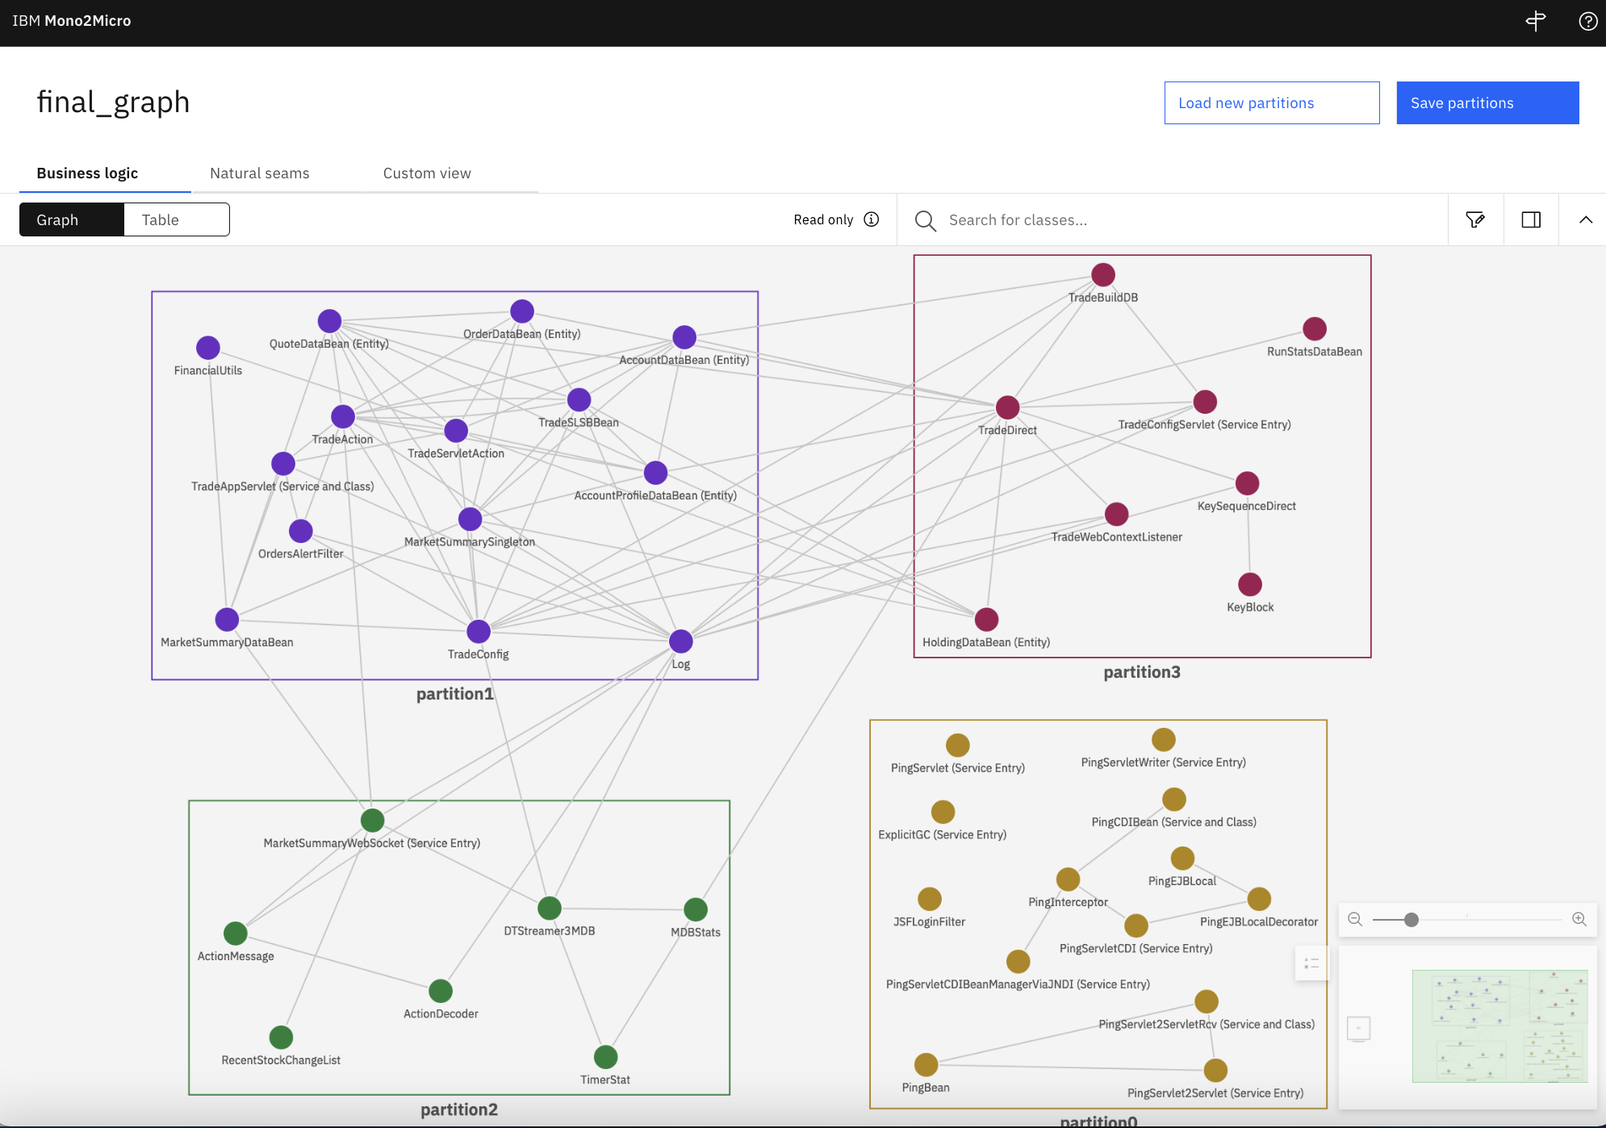


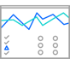

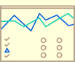
How IBM Mono2Micro works
User will install Mono2Micro on desktop.
Mono2Micro will analyze the monolith code.
Mono2Micro’s runtime agent will dynamically instrument the running monolith.
The Business usecase suite is run.
Mono2Micro’s AI analyzes resulting log files to recommend microservice partitions.
User will access the workbench in the browser to view and customize partitions.
Mono2Micro will refine customized recommendations, then transform the source tree and automatically generate the code to permit cross-partition communications.
Execute the same Business use case suite against the new microservice partitions in the Open Liberty or WebSphere Liberty runtime.
Desktop
Mono2Micro CLI
Microservices
Monolith

Slide 32
Partitioning Monoliths into Microservices
Java method call
REST API call

Slide 33
IBM Mono2Micro License and Entitlement
Licensing FAQ in Seismic →
Product name and version | License ID | Link to license
IBM WebSphere Hybrid Edition 5.1 | L-AMIK-C92MN6 | → Review license
WebSphere Application Server for z/OS 9.0.5.15 | L-QJFA-M33W3S | → Review license
WebSphere Application Server for z/OS 8.5.5.23 | L-LRGS-5TV3HE | → Review license
IBM Mono2Micro 23.0.06 | L-KNAV-6S5BZN | → Review license
Notes:
IBM Mono2Micro is available as a no cost 90-day trial. Trial information is located on this form: https://www.ibm.com/account/reg/us-en/signup?formid=urx-49257
Continued use beyond the trial evaluation period on certain platforms is available if a client has entitlement to any of the IBM products listed. WebSphere Hybrid Edition includes IBM Mono2Micro as part of it’s bill of materials. IBM Mono2Micro licensing information is available here: https://www.ibm.com/docs/en/mono2micro?topic=mono2micro-licenses Additional Licensing FAQ http://ibm.ent.box.com/v/Mono2MicroLicensingFAQ

Slide 34
IBM Mono2Micro system requirements
Platform/OS | IBM Mono2Micro 90-Day Free Evaluation | Prereqs | CPU | Free RAM | Free disk space.
Linux platforms macOS Windows | Yes | Requires Docker (18.0.03 or later) -or- Podman (1.0.0 or later) Java (1.8 or later) | Standard workstation CPUs are sufficient for running the IBM Mono2Micro containers | Minimum: 8 GB, 16 GB + improves performance | Recommendation: free disk space should be is at least 4x the size of the data collected for analysis
For latest, see documentation →
Notes:
For additional installation requirement information visit https://www.ibm.com/docs/en/mono2micro?topic=mono2micro-system-requirements .

Slide 35
Seller Guidance Typical Scenarios

Slide 36
Typical Scenarios after Discovery
Modernization Landing Zone
OpenShift on-prem
IBM Cloud Satellite Managed
Self-managed
RYO Clustering
Collectives
Financial Services Cloud
Storage
HA
DR
VMs
UCD
CPS
DataCentre Exit
Lift and Shift
Managed OpenShift/k8s
IBM Z
OpenShift on zCX/zLinux
Azure
IBM Cloud
z/OS
Run Liberty in any location or cloud, exactly as you need it.
On-premise, software and the Cloud Pak Systems appliance
Run Liberty yourself in public or private clouds
Let IBM manage OpenShift for you with its managed OpenShift via Satellite in public clouds and on-prem.
Notes:
Customers will have certain expectations and preferences about the landing zone for tWAS applications.
They may want to containerize. They then have the choice of a managed solution (via IBM Cloud Satellite) or a self-managed private Cloud, where they handle the Storage, HA and DR requirements themselves.
A customer may prefer the familiarity of VMs where collectives provides some elements of the clustering and management capability they are used to with tWAS. UCD and CPS have automation for provisioning and managing collectives. Others might prefer WAS Base only for cost reasons in which case they will need to roll their own clustering solution e.g. with F5 load balancer etc.
Customers who are exiting the DataCentre and e.g. moving to a Public Cloud may just be looking to lift and shift to a tWAS solution such as provided by Azure and IBM Cloud catalog offerings.
Finally customers on IBM Z may be looking at the new OpenShift based solution on zCX in addition to zLinux if containers appeal to them. Otherwise they have the option of running Liberty directly on z/OS with WAS for z/OS.

Slide 37
IBM App Runtimes – Scenarios for Distributed Sellers
Use WAS /Liberty – Run 1 VPC of entitled OCP with 1 VPC of any WAS at no additional cost. Therefore, no cost benefit of going to RH Runtimes on ICP4Apps.
Client has CP4Apps entitlement
YES : If client has OCP plans, or may have, they should continue with CP4Apps licensing, including expansion
What Runtime ?
1
Has OCP deployment plans ?
NO : If client has no OCP plans, then getting no benefit from CP4Apps, should do license exchange to WSHE.
Use WAS /Liberty – Run on WebSphere Liberty for containerized workloads for optimum savings. See Forrester TEI Study for benefits.
For non-containers run Liberty ND from WAS ND. Therefore, no TCO benefit of going to JBoss. See JBoss Competitive Analysis
WebSphere Network Deployment (ND) client
YES : Trade up to WebSphere Hybrid Edition for license flexibility to move to Liberty and supporting App Mod tools to facilitate migration.
2
Looking to Modernize?
What Runtime ?
NO : Maintain workload on Traditional WAS ND, or move to Liberty ND in VMs.
New Cloud Native Workload
Use Liberty / Open Liberty –
See the Liberty Sales Kit for comparison with other runtimes.
For new Cloud Native Workloads use supported Open Liberty, using 4:1 ratio in WSHE.
Comparative ROI Study (IDC Coming Soon)
3
Existing client?
YES : WebSphere Hybrid Edition for license flexibility for Liberty and Open Liberty for new cloud native workload
What Runtime ?
NO: WebSphere Hybrid Edition for license flexibility for Liberty and Liberty from WAS ND, in VMs

Slide 38
IBM Z Scenarios
Scenario | App Runtimes Sales Motion | Billing
Z Seller
New WebSphere Liberty workload running directly on z/OS | Sell WebSphere for z/OS | ShopZ
Modernizing COBOL workload running in CICS/IMS to Java | None – customer uses existing CICS/IMS | ShopZ
Distributed Seller
New WebSphere Liberty workload running in a container | Sell WebSphere Hybrid Edition plus one of | Passport Advantage
 | RedHat Open Shift Container Platform on IBM z/OS Container Extensions | IBM License Service
 | IBM z/OS Container Extensions | IBM License Metric Tool (ILMT)
Modernizing from traditional WebSphere on z/OS to containers | No easy way today | Passport Advantage
Partner building Liberty Application for z/OS | Sell ESA - WAS Base w/without Liberty only restriction (cheaper) versus Partner using Open Liberty (unsupported) | Passport Advantage
Notes:
Containers running on RedHat OpenShift Container Platform will be tracked by the License Service. See https://www.ibm.com/software/passportadvantage/containerlicenses.html.
Containers in zCX Container Extensions can be ILMT enabled. However, customer will be charged for the full hosting capacity and not just the container. This is the same as Docker on distributed.

Slide 39
IBM Z modernization scenarios
Continue to run Java applications on z/OS near Systems of Record using WebSphere for z/OS (including z/OS and ND features) Handelsbanken Use Case
Adopt distributed OpenShift + IBM ModStack for consistent hybrid cloud operations (optional)
WebSphere Liberty
z/OS
IBM Z
Modernize on Mainframe (same physical box)
WebSphere Liberty
Use TA to Replatform Java applications to OpenShift. (dropping z/OS and ND APIs as well as WLM)
Run Java applications on OpenShift but retain low latency connection to z/OS Systems of Record e.g. Db2 Acquire WSHE, zCX or OpenShift on zCX
OpenShift
WebSphere for z/OS
zCX
IBM Z
z/OS
Note. Today zCX is approx 5% better than zVM, will improve in 1 year
s/390
WebSphere Liberty
OpenShift
Use TA to Replatform to OpenShift (dropping z/OS and ND APIs)
Switch from Type 2 to Type 4 JDBC driver Acquire WSHE, OpenShift and (optional) ModStack licenses
Consider cost considerations of cheaper hardware versus the latency question with being collocated on same box (2x faster)
z/VM
Modernize to Hybrid Cloud (new hardware)
IBM Z
WebSphere Liberty
Use TA to Replatform to OpenShift (dropping z/OS and ND APIs) Acquire WSHE + OpenShift licenses
OpenShift
x/Linux
IBM Cloud/AWS/Azure
Notes:
Note. WebSphere ND can utilize Service classes for Performance goals with WLM, good at different processes. Liberty needs enclaves.
Unleash Mainframe Applications by Augmenting New Channels on AWS with IBM Z and Cloud Modernization Stack - Technical (L200) WATCH ON DEMAND
--
Are CP4A customers entitled to run OpenShift on zCX? No
Are CP4A customers entitled to run WebSphere/Liberty on zCX? Yes, at the normal 1,4,8 ratios.
What is Financial Services Cloud angle here
https://medium.com/hybrid-cloud-engineering/ibm-cloud-satellite-and-regulated-workloads-1c30e915594e
https://aws.amazon.com/blogs/apn/unleash-mainframe-applications-by-augmenting-new-channels-on-aws-with-ibm-z-and-cloud-modernization-stack/

Slide 40


Use opportunity accelerators to progress, land and expand
Free Trials
Demonstration
IBM Client Engineering (formerly Technology Garage)
Expert Labs Workshops
IBM Business Partners
Notes:
There are resources and tools available to help speed up the time from opportunity identification through to closing the deal. There are also activities, workshops, that will help further expand use of IBM technology which feeds the ‘land and expand’ selling motion. These are some of the ways a seller can attach services to opportunities.
IBM Mono2Micro Demo: https://www.ibm.com/account/reg/us-en/signup?formid=urx-49569 (registration is requested). Demos and trials are a great way to show the value of IBM technology.
Suggest a trial:
IBM Cloud Transformation Advisor: https://www.ibm.com/account/reg/us-en/signup?formid=urx-49064
IBM Mono2Micro: https://www.ibm.com/account/reg/us-en/signup?formid=urx-49257
IBM Client Engineering: https://ibm.seismic.com/Link/Content/DCAkaCMksC_kGGpmt9lmigvQ gives an overview and how to engage along with assets to use with clients.
Expert Labs Modernization offers: https://ibm.seismic.com/Link/Content/DC0nQWPiqzmkmq1XCMsgItvg#/?anchorId=acc816d3-58d9-4e3d-89aa-e47b062c042c
Expert Labs Seismic page which outlines how they can assist in selling, progressing and more: https://ibm.seismic.com/Link/Content/DC0nQWPiqzmkmq1XCMsgItvg

Slide 41
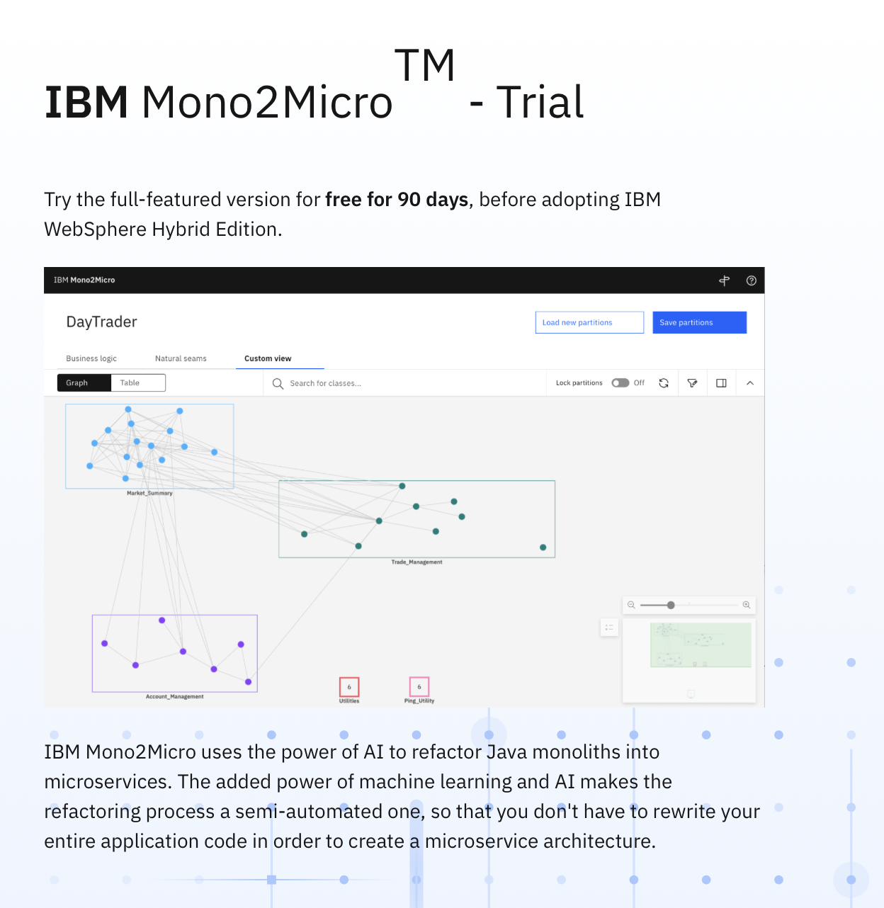
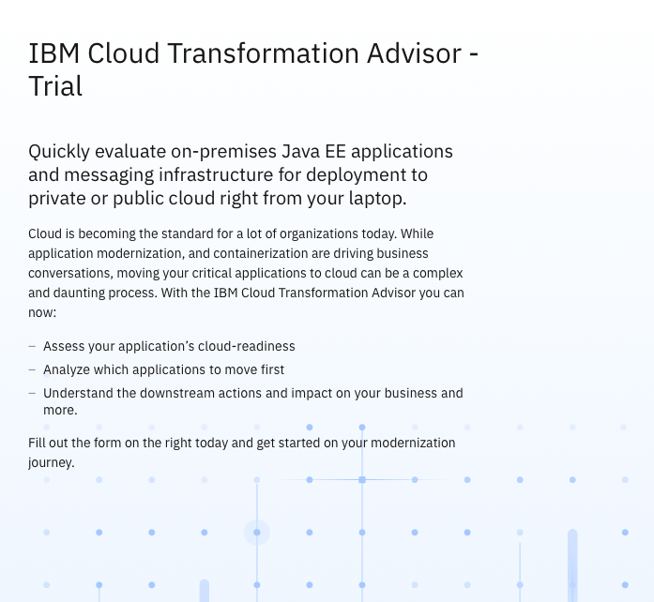
Tooling 90-day Trials available
Try it: Transformation Advisor
Try it: Mono2Micro

Slide 42
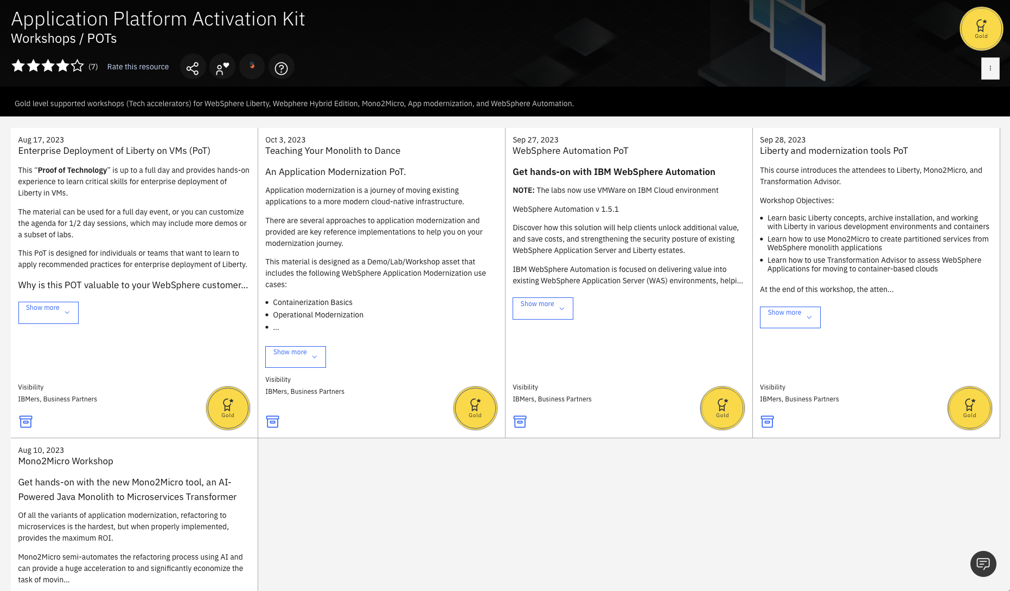
Workshops / PoT Assets

Slide 43
Expert Labs Application Modernization Client Journey
Client: Training and subscription series
Observe and understand
Business Alignment
Implementation
Production Deployment
Expert Labs Engagements
Modernization workshops
MVP to Deployment
Discovery workshops
Design Thinking workshops
Value
Solution Architecture workshops
Cloud Architected or Hybrid Enterprise scale business models
Native or Hybrid or Full cloud?
Use case Priority
Legacy “on premise” architecture
Change and deployment modelling
Use cases as working MVP solutions
Business transformation
Maturity
Notes:
The path to WebSphere Hybrid Edition is not an event but a journey (moving up the maturity ladder). Engaging Expert Labs early in the planning phase is important to the overall client success.
Determining the relevant workshop to help the client progress is key. IBM and its Partners have offerings and workshops for every step of the journey. Examples include:
Observe and Understand:
• Ensure you know where a client is starting from. Are they native or hybrid? Do they have the right in-house skills to support their project? Understand their legacy architecture and start to understand what is important to them and what areas can be improved by automation and modernization.
Business Alignment:
• Define and Design areas to architect aligned with business needs. Define use cases. The Modernization Workshop https://ibm.seismic.com/Link/Content/DCpY_D5Df2X0e__gvr4fZsDg is ideal for any WebSphere client. This workshop can be executed by IBM sellers as well as IBM Partners engaging IBM to team up. IBM Partners may also have a version of the same workshop. Workshops are designed to not only identify immediate needs but to also provide opportunity for a strategic discussion to expand use of technology in new ways, new services.
Implementation:
• Install, upgrade, and deployment services can be used where needed. It is important to prioritize the use cases based on business needs. Investment workshops will help to define an actionable adoption roadmap based on the client’s business priorities. Those become the working Minimal Viable Product (MVP) solutions to help accelerate WebSphere Hybrid Edition adoption and become the entry level working architecture that can be extended and enhanced (with additional automation and integration)
Production Deployment:
• Iterative MVPs and scaling solutions from pre-production into production. Ensure in-house staff are equipped with the skills needed today and those need to support future growth
Throughout this journey it is key to note that IBM has client training options from planning and base skills alignment to scaling and expertise skilling. IBM subscription services can be paired with our consultative offerings or stand alone to assist our clients proceed along their journey as well. IBM also has skilled ecosystem partners as key members of our go-to-market strategy. IBM Expert Labs works closely with IBM business partners in a bi-directional teaming for client success whenever needed.

Slide 44
Expert Labs Approach to Application Modernization
Plan
Build
Adopt
Scale
WHE, MQ, APIC, DataPower, Asper, Confluent
Subscription Services (Essential Management + Expertise Connect)
Adoption Workshop
MVPs
(4-8 Weeks)
MVPs deployed to resolve customer pain points
Responds to events in real-time
Access and Move Data across systems
Create and Manage APIs
Business Framing
(1 hour)
Solution Assessment (4-8 hour)
Solution Architecture Workshop (1-2 Weeks)
Accelerate Transformation with Modernization
Delivery with AI-Powered Integration
Protect Transactional Integrity across data sources
Secure Business to protect access
Outcome
Introduction
Learn business plan points priorities and goals
Agree on next steps
Outcome
Share client experiences
Industry trends
Align with business
In-house skill requirements
Agree on next steps
Outcome
Requirements and sizing Deployment architecture
Implementation plan agreed to
Design Thinking
(1-2 days)
Balance workloads to optimize resiliency
Optimize applications & operations to lower costs
Cloud enable IT estate with AI and Automation
Outcome
Understand current state of technology adoption
Identity us cases / MVPs
Prioritize MVPs
Roadmap for adoption
Client Training Services
Notes:
At the highest level, Plan, Build, Adopt, and Scale are the 4 client journey phases.
IBM Expert Labs can help clients along their journey to their desired technology adoption and maturity levels. Engage with Expert Labs early in the sales cycle. The modernization assessment and deployment acceleration workshops can range from 2-5 days depending on the type of workshop.
This diagram is not intended to overwhelm with the details behind these offerings but rather to show the logical progression from left to right starting with assessing the right solution and use case for each client with a discussion on how inhouse skills might be bolstered to support new models of computing. This is followed by a solution architecture that leads to the construction of the related Minimum Viable Products needed to support the client's use case solution.
Along the journey, client training services are available to support the project planning all the way through ongoing administration and management tasks.
IBM also has subscription services that can be paired with consulting services or as standalone offerings, depending on the client’s preference or in-house skills maturity levels.
Clients can email IBM Expert Labs at labs@us.ibm.com with any questions or visit the website https://www.ibm.com/products/expertlabs
Find more information on Expert Labs in Seismic:
Main Expert Labs - ibm.biz/CC-ExpertLabs Expert Labs Automation - ibm.biz/ExpertLabs-Automation
Expert Labs WebSphere Hybrid Edition: http://ibm.biz/ExpertLabs-WSHE

Slide 45

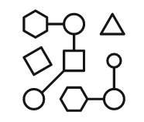
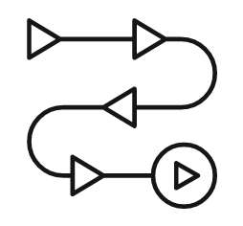
Expert Labs | IBM Automation Services Offer
Driving Adoption and Consumption of Cloud Paks
Assessment Workshop
(3-5 Days, No Charge)
Assess existing workloads and plan next steps
Jump Start
(3 Weeks Consulting + Enterprise Learning Subscription)
Build a scalable infrastructure
Accelerate
(6 Weeks Consulting + 3 Month Enterprise Connect)
Build, deploy the MVP
IBM SME led quick assessment to get insights of the existing workloads
Identify the best modernization approach that will protect existing investment
Actionable plan that will provide immediate value for the business
Installl and configure OpenShift Container Platform
Deploy Cloud Pak capabilities with common services required to deploy workloads
Validate the environment with an initial sample application
Build a scalable OpenShift and Cloud Pak infrastructure
Modernize and deploy 1-2 applications to achieve new levels of efficiency
Provide continuous support to stabilize and optimize the solution
Services Offer
Quick assessment to get valuable insights for existing middleware estate and identify the best modernization approach that will provide quick value to the business
Quickly build a scalable Cloud Pak environment ready to deploy your critical solutions
Realize the value of Cloud Pak by deploying and operationalizing your initial solution
Value
No Charge, sign up with a one click digital agreement or a commitment letter
Paid Services, transact using an IBM statement of work or part numbers
Paid Services, transact using an IBM statement of work or part numbers
How to Transact
IBM Confidential / © 2021 IBM Corporation

Slide 46
Resources on the Web
People Resources
Seismic links: WebSphere Hybrid Edition Sales Kit →
Product Pages:
WebSphere Hybrid Edition →
IBM Cloud Transformation Advisor →
IBM Mono2Micro →
Customer Engagement Assets:
CSM Playbook →
Workshops / PoT Assets (TechZone) →
Enablement
Application Runtime Talks →
Training
Instructor Led (WA615) →
Self-paced (ZA616G) →
Customer Advisory Board:
WebSphere and Liberty CAB →
Product Manager
John Buckley, john.buckley@ie.ibm.com →
WW Sales Leader
Gary Juvinall, gjuvinall@us.ibm.com →
WW Technical Sales Leader
Kevin Postreich, kevinlp@us.ibm.com →
Expert Labs WW Practice Leader
Hendrik van Run, hvanrun@nl.ibm.com →
GTM WW lead, Application Runtimes
Jyoti Shrian jshrian@us.ibm.com →
Global Sales Ecosystem
Burt Hughes, buhughes@us.ibm.com →
Technology Sales Enablement
Yi Tang, yitang@us.ibm.com →
Trials
90 day → 90 day →
Services:
Main Expert Labs →
Expert Labs Automation →
Expert Labs WebSphere Hybrid Edition → Expert Labs Client Training - →
a
Notes:
This is a starter list of web and people resources. Sellers will want to add geography contacts, and other websites of interest to the list as well.
Seismic URLs:
Sales Kit: https://ibm.seismic.com/Link/Content/DChKPVZoSYh0OSWJSDF9j19w
Services:
Main Expert Labs – ibm.biz/CC-ExpertLabs
Expert Labs Automation - ibm.biz/ExpertLabs-Automation
Expert Labs Client Training - ibm.biz\ellearn
External:
IBM WebSphere Hybrid Edition: https://www.ibm.com/cloud/websphere-hybrid-edition?lnk=STW_US_STESCH&lnk2=learn_WebsphereHybrid&pexp=DEF&psrc=NONE&mhsrc=ibmsearch_a&mhq=websphere%20hybrid%20edition IBM Cloud Transformation Advisor and IBM Mono2Micro can be found on the same external page as they are included with IBM WebSphere Hybrid Edition.
Training (Instructor Led and Self-paced):
Describe the key concepts and reference implementations for application modernization
Use Podman to create and manage container images
Use Transformation Advisor to assess an application
Implement operational modernization: repackage and deploy a traditional WebSphere application to a container runtime
Implement runtime modernization: repackage and deploy a Liberty application to a container runtime

